Slide 1

Anodization and In-situ Testing of Titanium Alloys for Capacitor Anodes
July 22, 2011
Steven Ehret

Slide 2
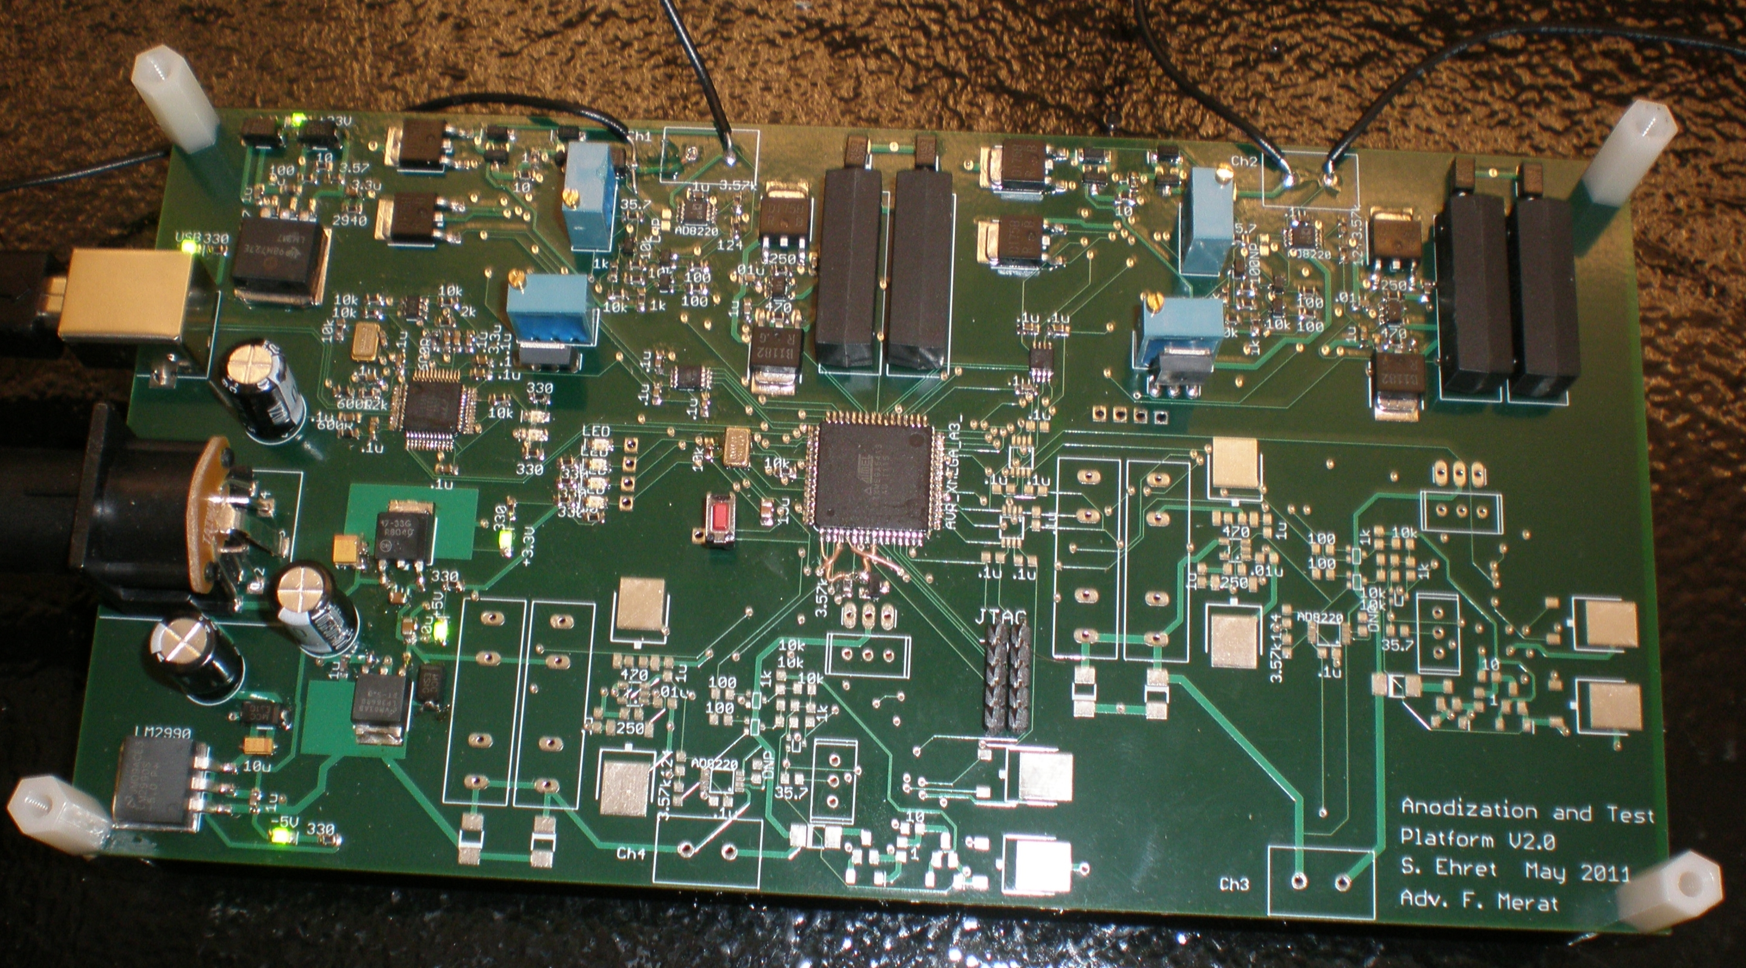
Presentation Overview
Aims of Work
Background
Technical Design
Results and Conclusions
Future Work

Slide 3


Acknowledgements
Dr. Frank Merat
Dr. Gerhard Welsch and Don McGervey
Dr. C.C. Liu and Laurie Dudik
US Department of Energy and ARPA-E

Slide 4
Aims of Work
Aid Development of Materials for High Energy and Power Density Capacitors by:
Instrumentation to create capacitor anodes while recording voltage and current data during the process
Test platform to provide first order testing of new materials as capacitor anodes

Slide 5
Aims of Work
Design Specifications
Digitally programmable current source 1 – 100 mA
Programmable compliance voltage of 0 – 30V
Measure and record voltage across load 0 – 30V, 10 bit
Measure and record current through load 10nA – 100mA, 10 bit
Multiple channels
Computer interface

Slide 6
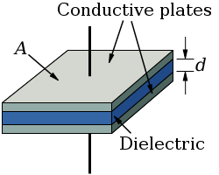
Background – Capacitor Overview
Capacitors
Dielectric Constant - ε_{r}
Energy
Notes:
Capacitor - Energy Storage Device
Accumulation of charge → field → stored energy

Slide 7

Background – Non-Idealities
Equivalent Series Resistance – ESR
Imperfect Insulator
Leakage Current
Voltage Limitations
R_{S}
C
Notes:
ESR
Heating, shortens life always
Power limitations
Imperfect Insulator
Defects allow leakage current
Will breakdown at some voltage
ESL
Mainly due to packaging, reason not discussed

Slide 8
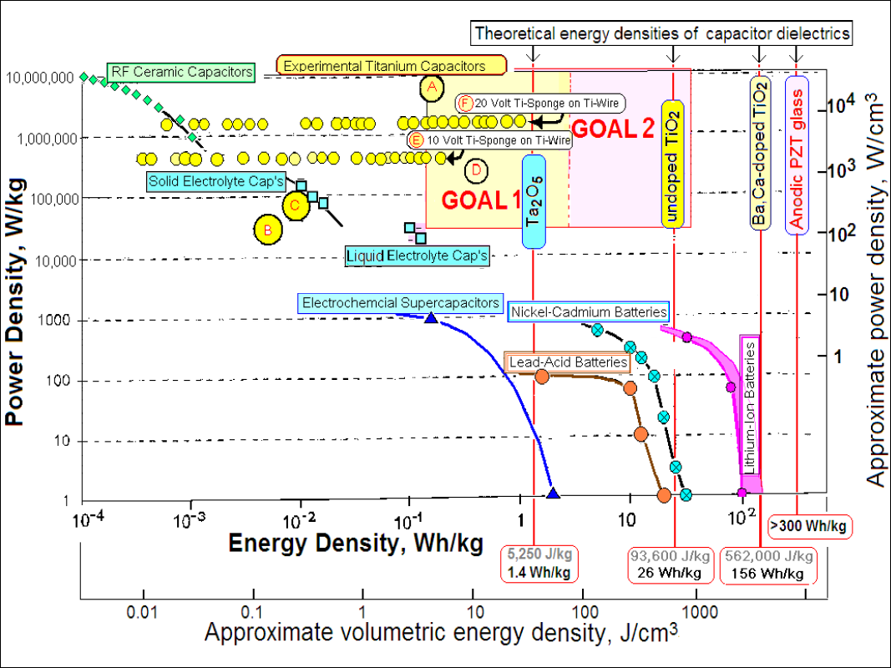
Background – Ti Based Anodes
High Energy and Power Density Capacitors

Slide 9
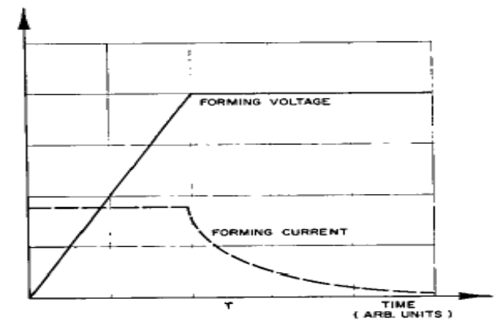
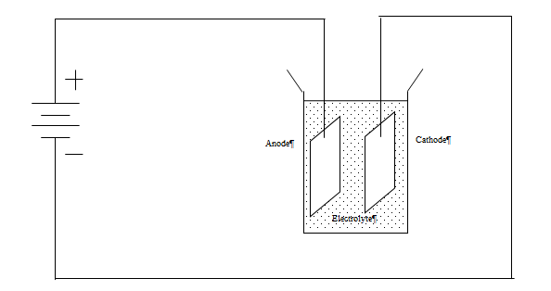
Background – Ti Based Anodes
Performance limited by high leakage currents in previous work
Newly developed Ti alloys are promising to reduce the leakage current to levels currently accepted by industry
Anodes created via process of anodization
Notes:
10 nA/uF*V

Slide 10
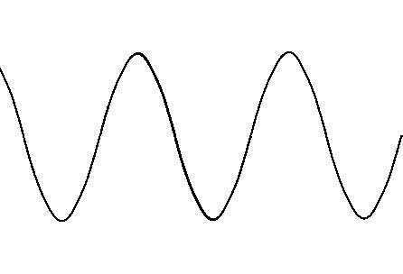
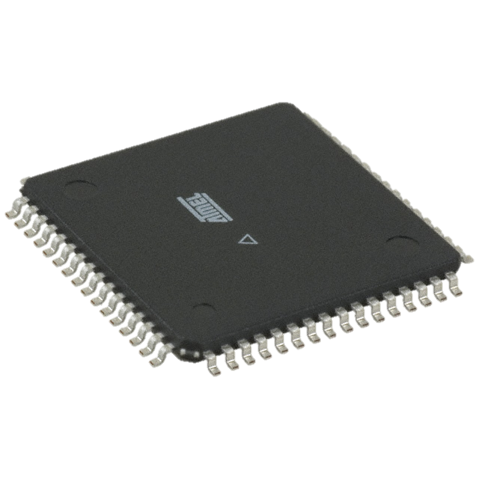
Background - Instrumentation
Analog Control Circuitry
Analog to Digital Conversion
Microcontrollers
Software
User Interface
Communication
Long Term Data Storage
10010111

Slide 11
Technical Design
System Level Design
Preliminary Design Overviews
Final Design
Analog Circuitry
Digital Circuitry
Firmware
Software
Calibration
Test Setup

Slide 12
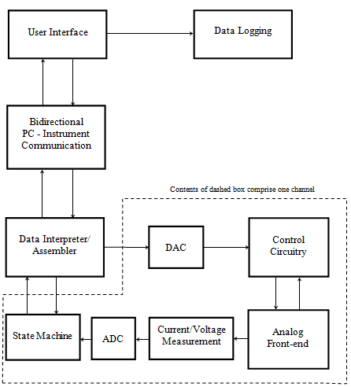
System Level Design

Slide 13
Preliminary Design Overviews
Prototype I
Off-the-shelf data acquisition solutions
Focus on analog front-end
Logarithmic amplifier to achieve full dynamic range
Barebones construction, single channel
Shortcomings
Off-the-shelf DAQ solutions unacceptable
Large absolute accuracy error
High Cost

Slide 14
Preliminary Design Overviews
Prototype II
Microcontroller for ADC and control signals
Focus on computer interface via UART
Minor improvements to analog front-end
4-layer custom PCB
Shortcomings
Sampling rate of ADCs not fast enough
More ADC resolution desired
Current source limited to approximately 50 mA

Slide 15
Final Design – Analog Circuitry
Voltage Compliance
Current Source and Control
Current Sink and Control
Current Measurement (Transimpedance Amplifier)
Voltage Measurement
Filters

Slide 16
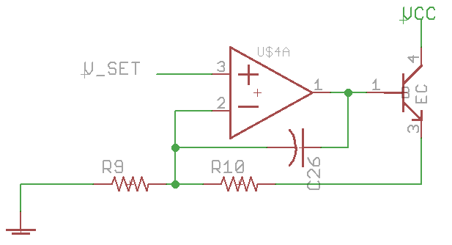
Voltage Compliance

Slide 17
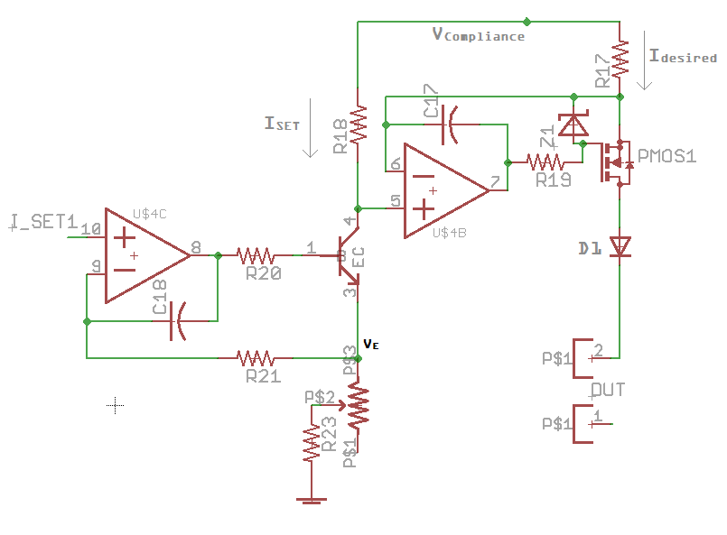
Current Source and Control

Slide 18
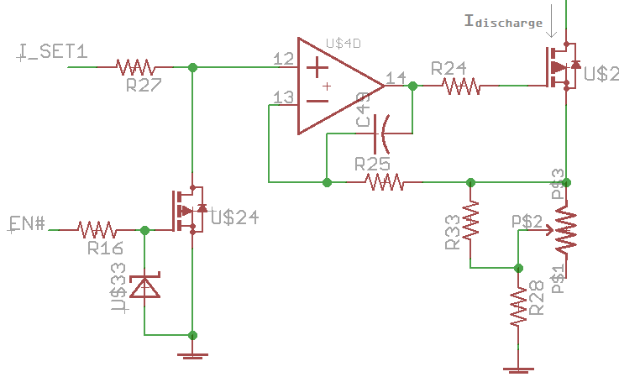
Current Sink and Control

Slide 19
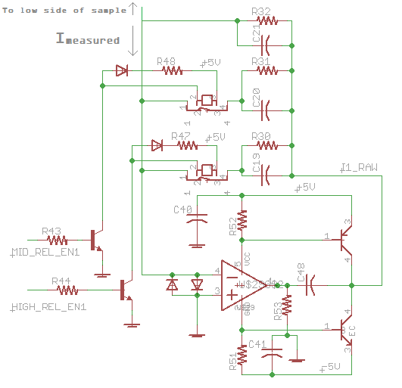
Current Measurement

Slide 20
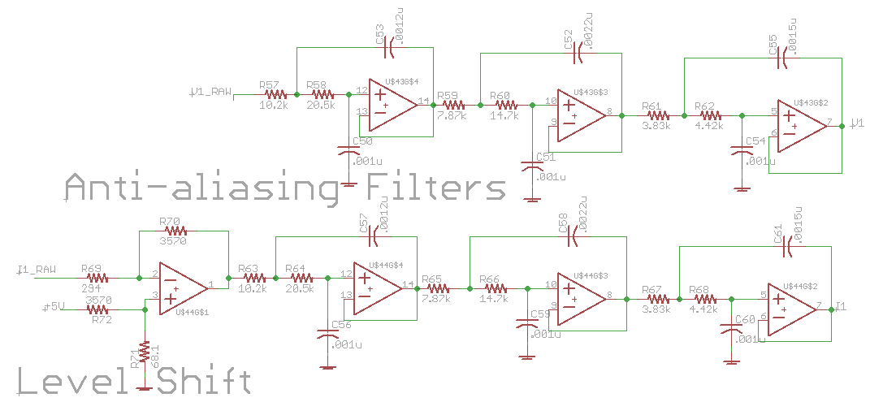
Filters

Slide 21
Final Design – Digital Circuitry
Microcontroller
Board to Computer Communication
Analog to Digital Conversion

Slide 22
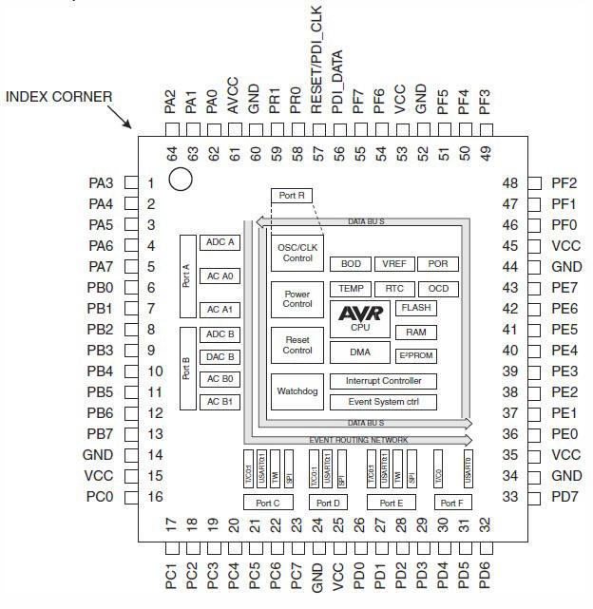
Microcontroller
ATXMEGA64A3
Serial Communication: UART, SPI
ADC
General Purpose I/O

Slide 23
Board to Computer Communication
Connects via USB
FTDI FT232H USB to UART
2Mbaud serial connection
Custom packet structure and protocol

Slide 24
Analog to Digital Conversion
2 physical, 12-bit, 1 MSa/s pipelined ADCs
4 virtual channels per ADC
1.22V reference voltage
Differential Inputs

Slide 25
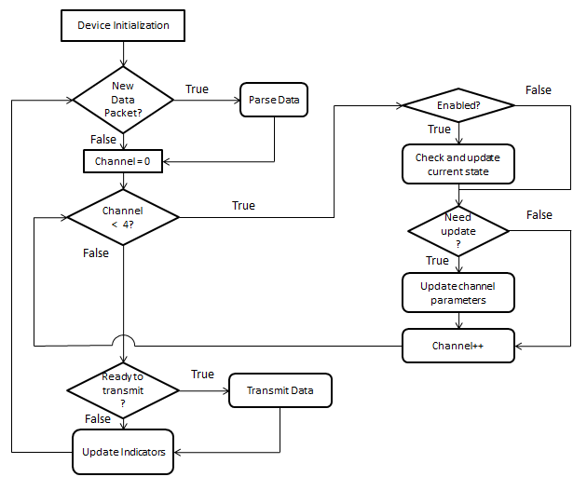
Firmware

Slide 26
Software
MATLAB used to communicate with device and record data
Limited features, intended for preliminary testing
Fully functional GUI and data recording platform to be implemented in NI LabVIEW

Slide 27
Calibration
Hardware
Current Source potentiometer calibrated to 20 mA
Current Sink potentiometer calibrated to 20 mA
Software
ADC offset null
Auto-zero functionality when microcontroller starts up
ADC Characterization

Slide 28
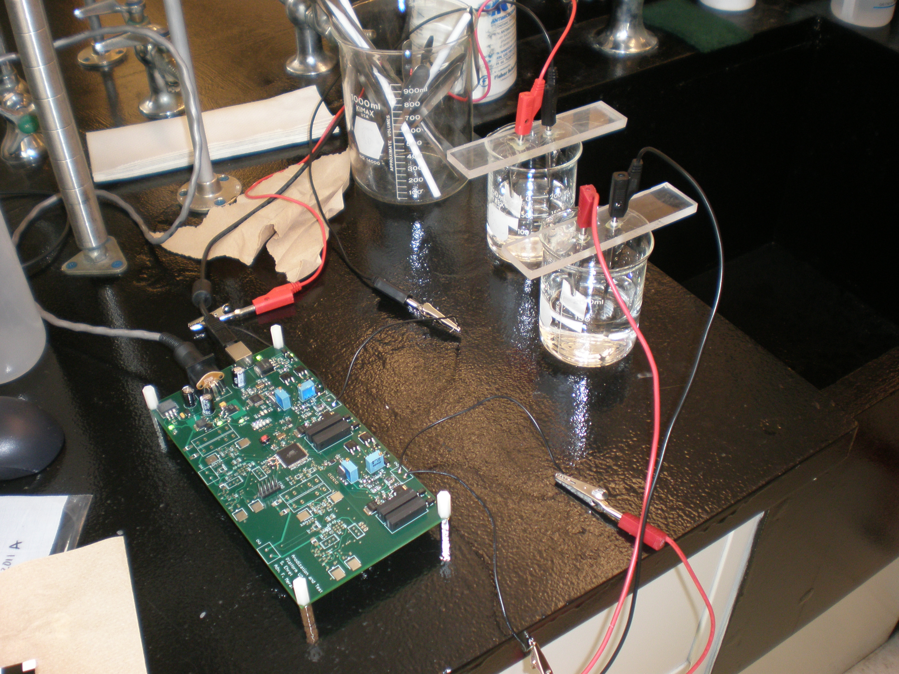
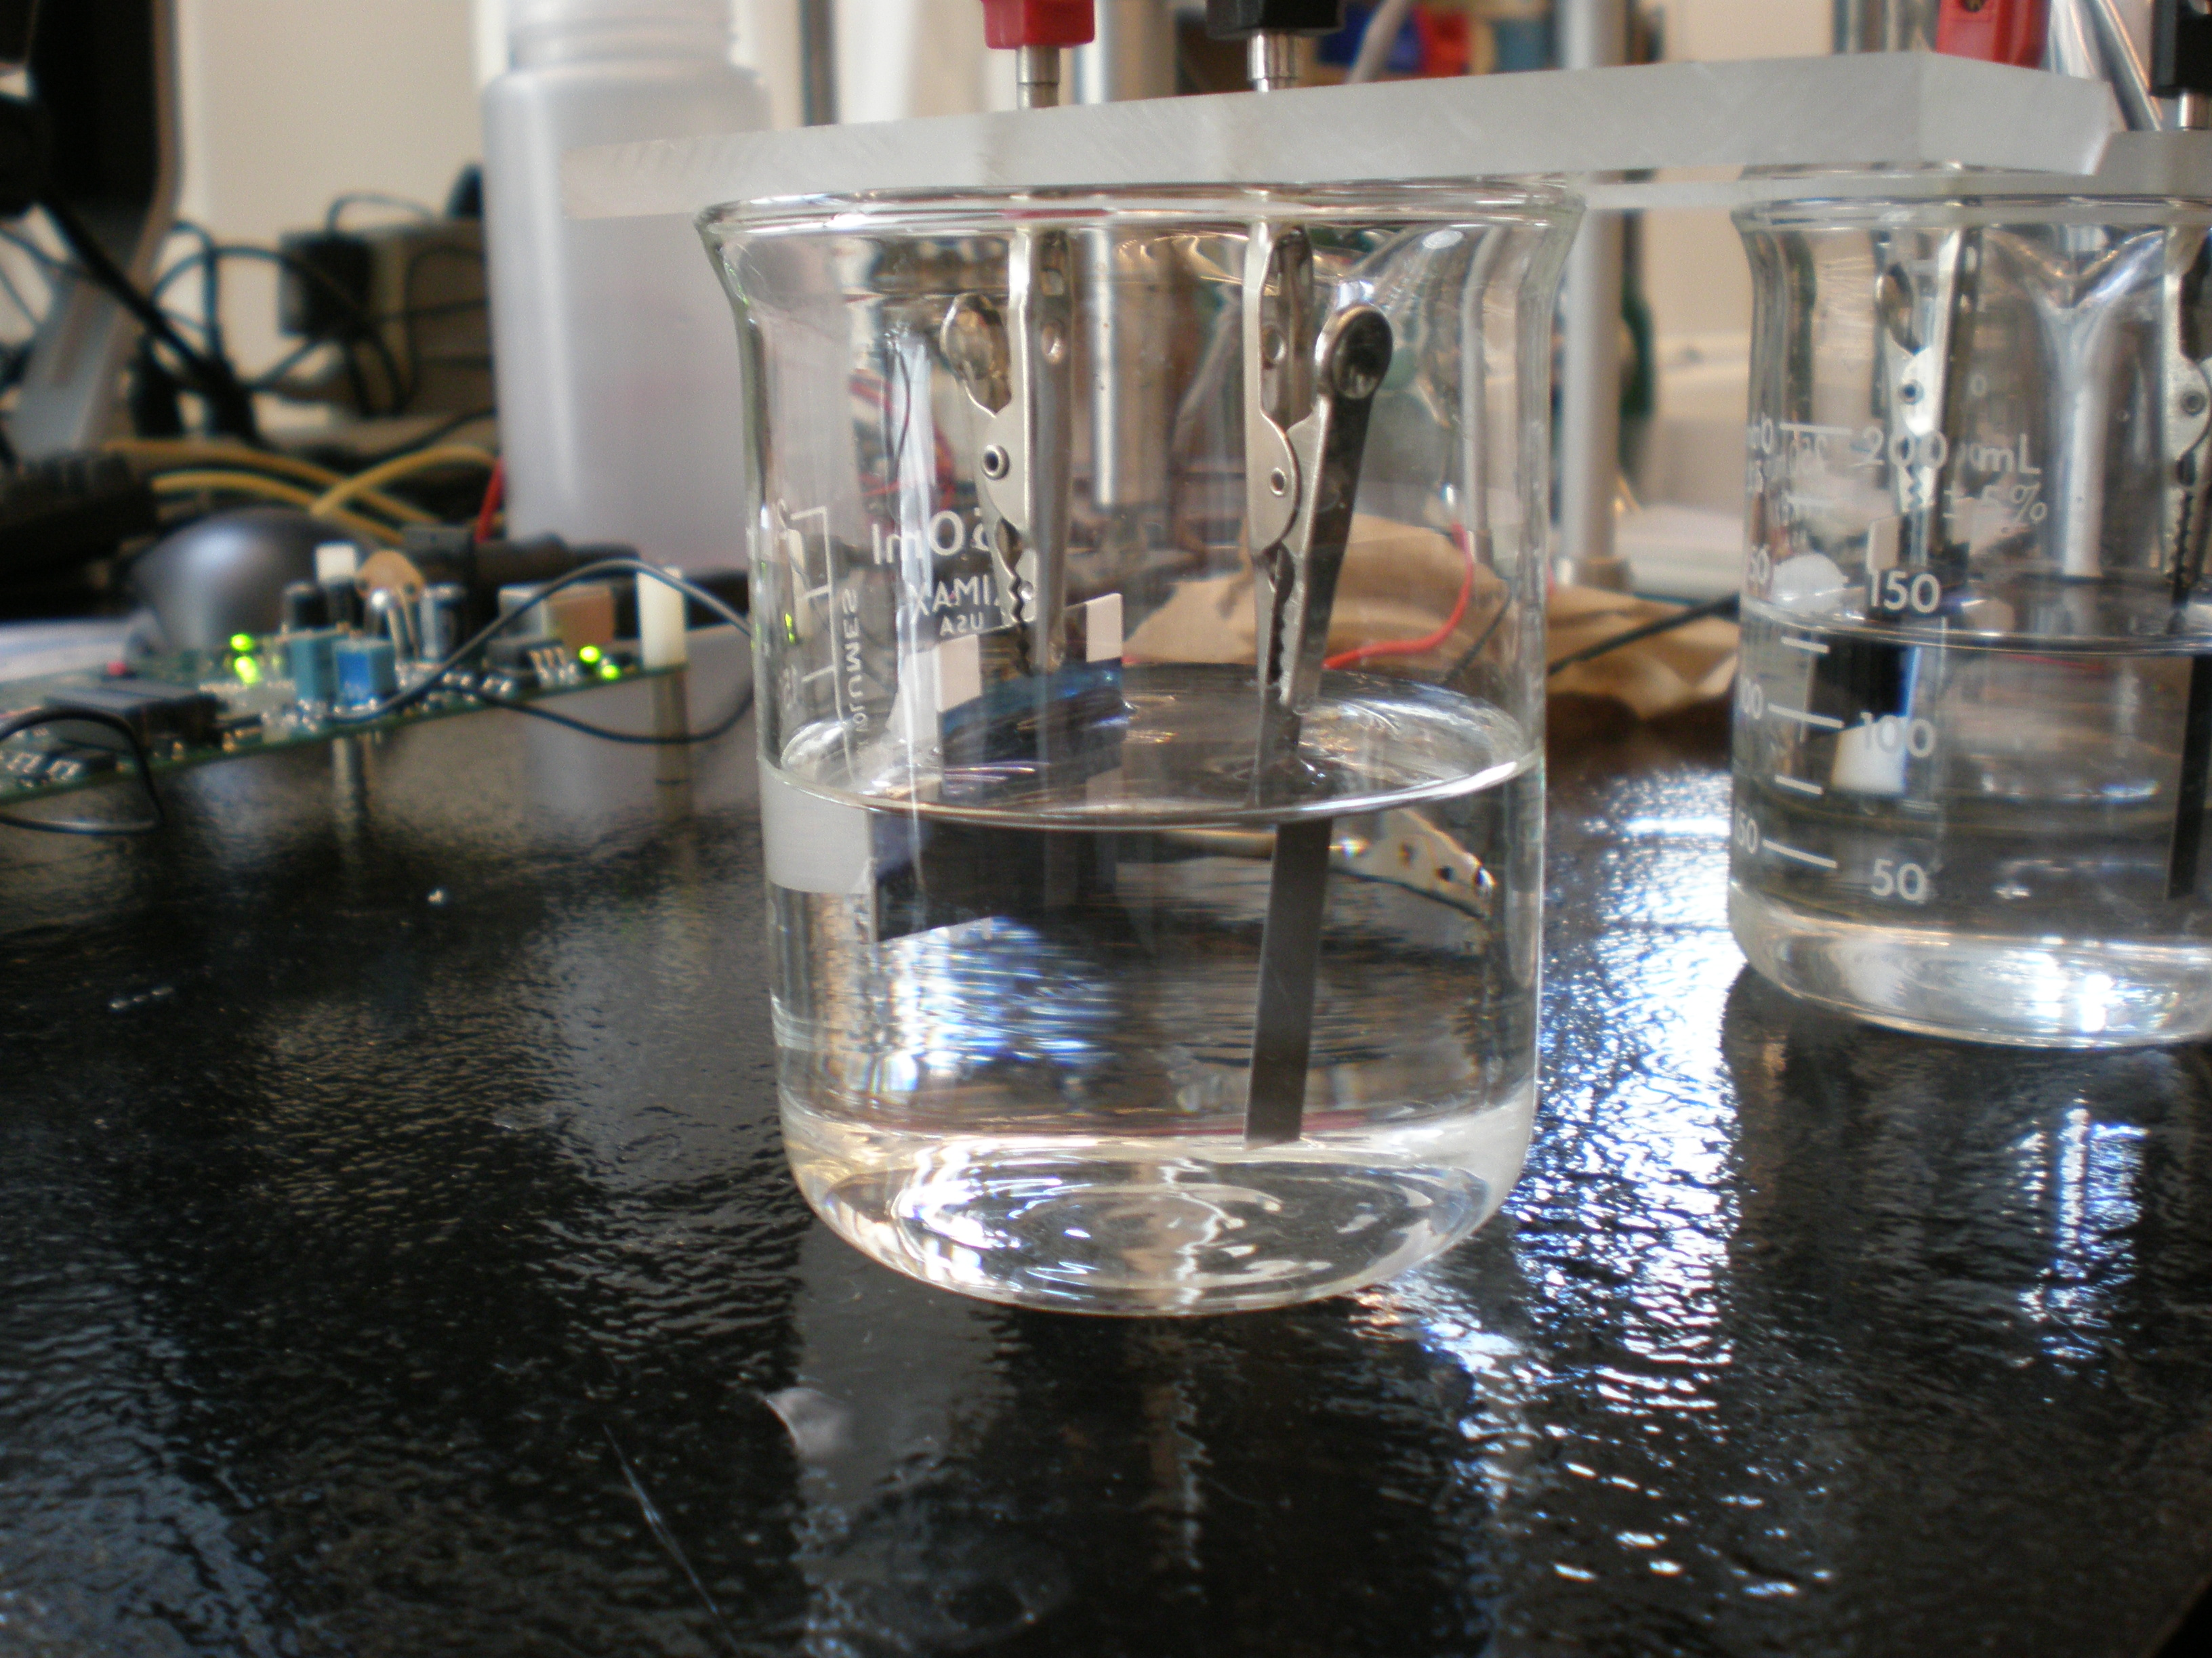
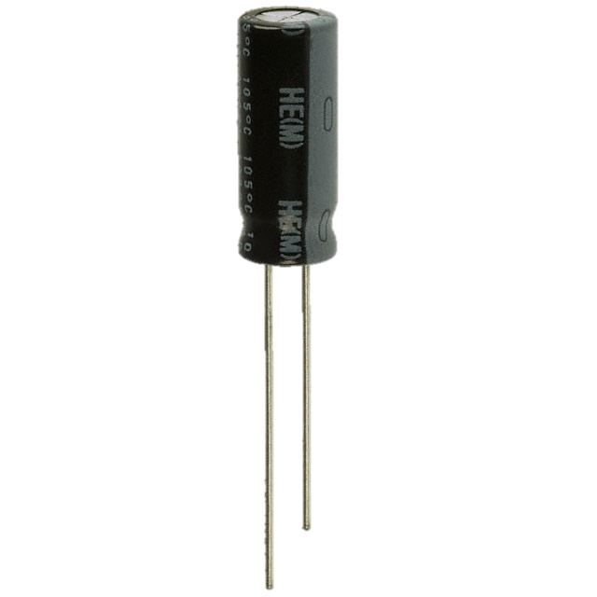
Test Setup
Commercial aluminum electrolytic capacitors used as reference
Tested by anodizing samples of thin-film alloys of Ti, Zr, Ta, and Pb in 1% and 5% H₃PO₄

Slide 29
Results and Conclusions
Measurement Error
Anodization Results
Testing Results
Conclusions

Slide 30
Measurement Error
Sources of Error
ADC
INL:+/- 5 LSBs Max, +/- 2 LSBs Nominal
Offset: +/- 2 mV
1.22 Volt Reference
+/- 1%
Op-amp Input offset voltage
2.5 mV
Resistor Tolerances
+/- 1%
System Noise – Thermal, EMI, etc.

Slide 31
Measurement Error
Mitigation of Errors
ADC
INL: Nothing, +/- 5 LSB error = 5/2^11 = 0.24% error
Offset: Offset-null routine during device startup
1.22 Volt Reference
Auto-zero routine during device startup
Input offset voltage
Auto-zero routine during device startup
Resistor Tolerances
Auto-zero routine during device startup
System Noise - Averaging

Slide 32
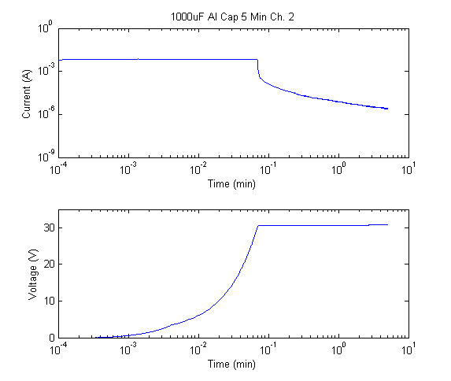
Results
Reference

Slide 33
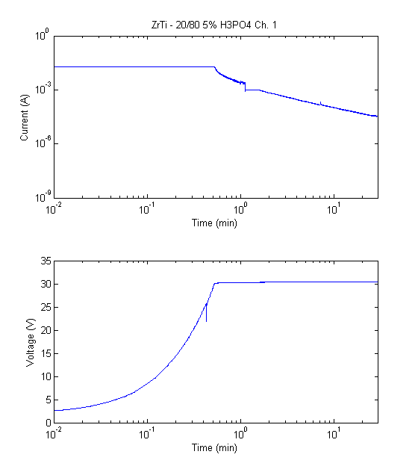
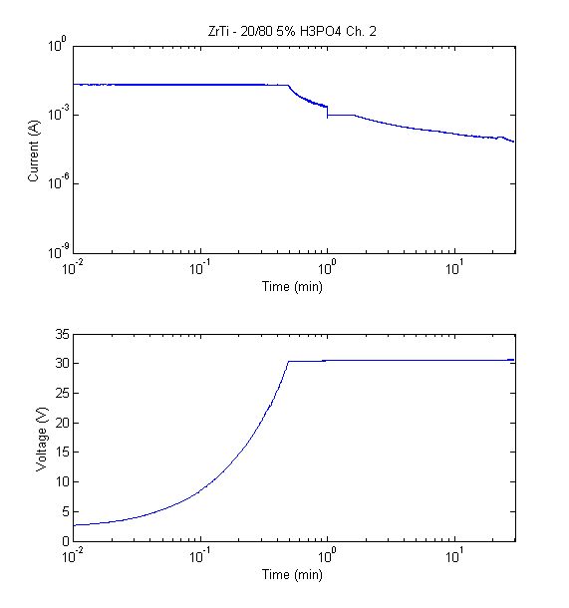
Results
Anodization

Slide 34
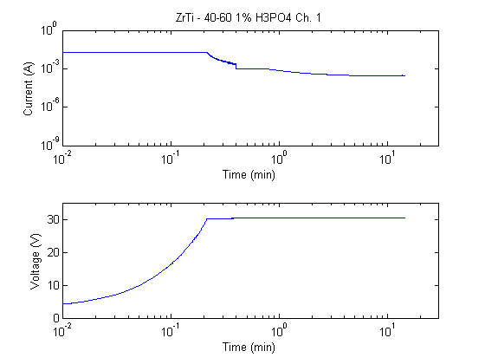
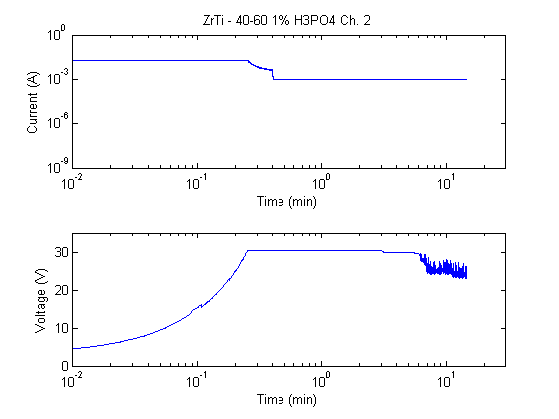
Results
Anodization

Slide 35
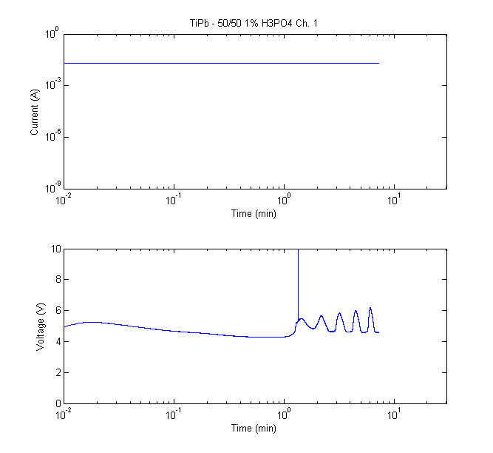
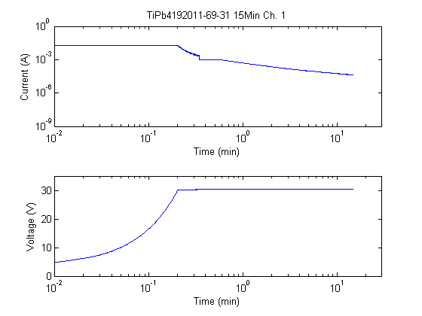
Results
Anodization

Slide 36
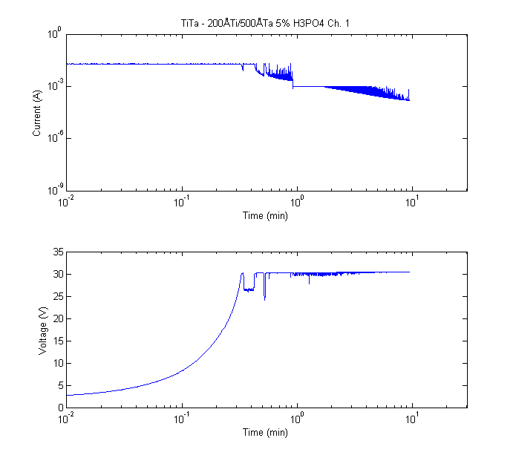
Results
Anodization

Slide 37
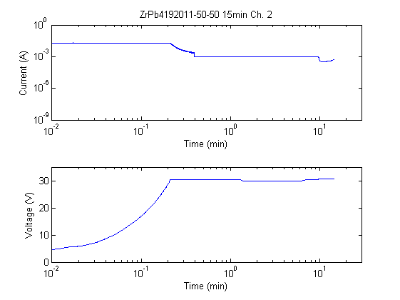
Results
Anodization

Slide 38
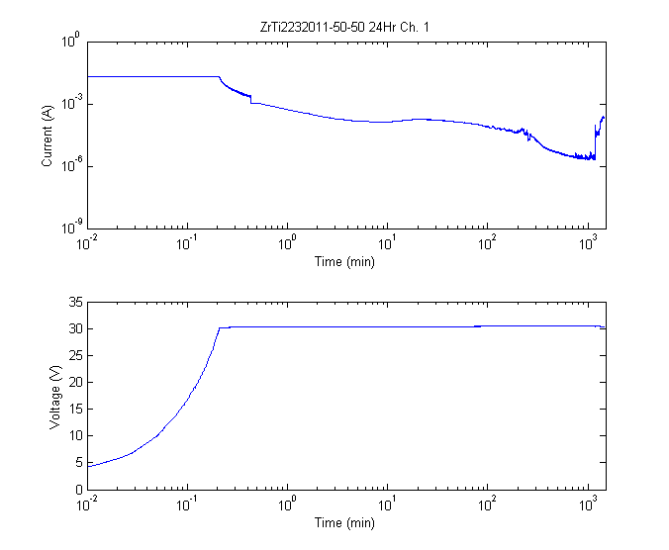
Results
Anodization

Slide 39
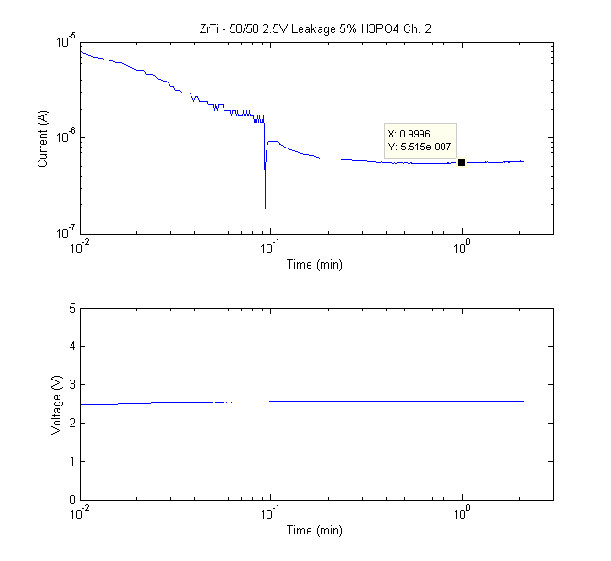
Results
Leakage Current Measurement

Slide 40
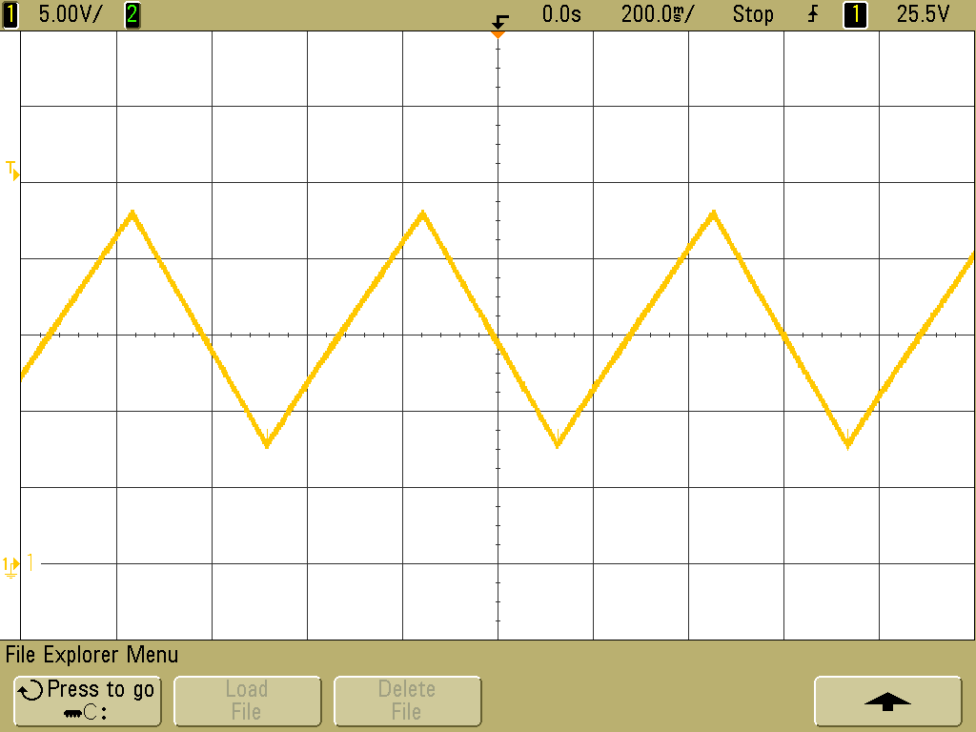
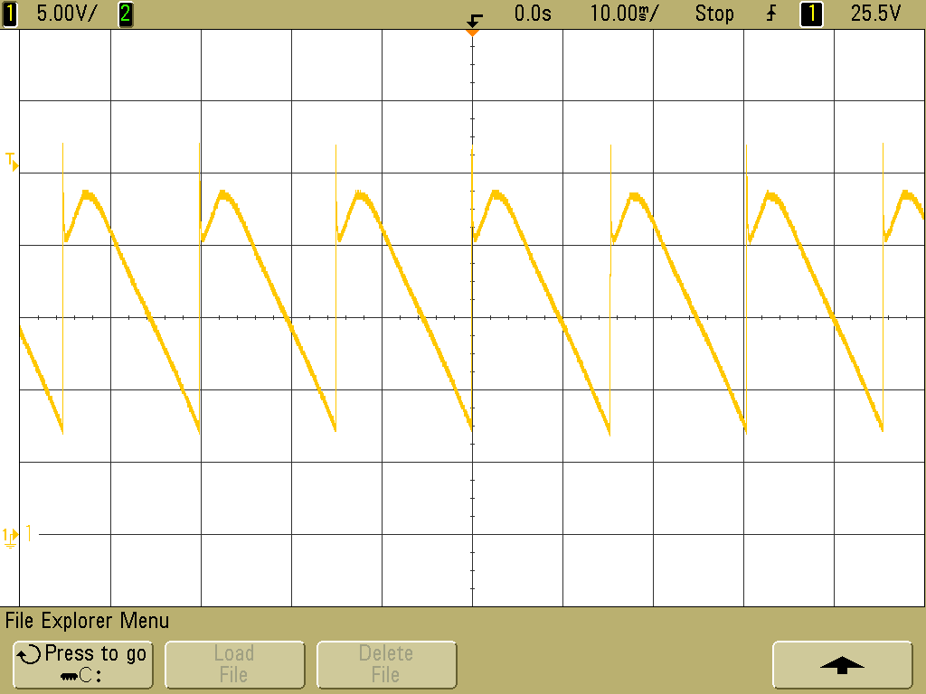
Results
1000uF Load 1uF Load
Testing

Slide 41
Conclusions
Anodization function of instrumentation successful and useful to identify important characteristics of anode material for capacitors
Testing function of instrumentation only useful for large capacitive loads

Slide 42
Future Work
Device Improvements
Expand to 4 channel functionality from 2 channels currently
Allow testing mode to be used for large and small capacitive loads
LabVIEW user interface
High voltage version

Slide 43
Questions?

